Slide 1

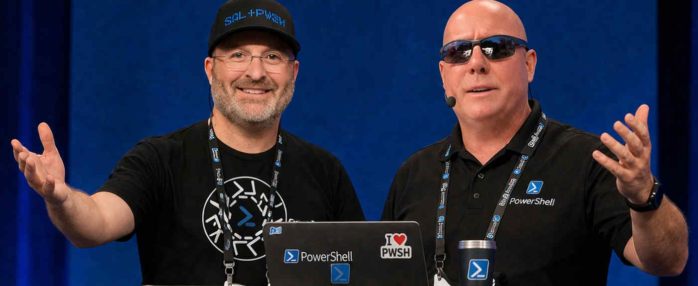


github.com/devops-collective-inc/OnRamp-2026/
OnRamp Welcome & Orientation
OnRamp Team

